Slide 1
Unit 13 : Where’s my book?
Lesson 1

Slide 2
Lesson 1

Slide 3
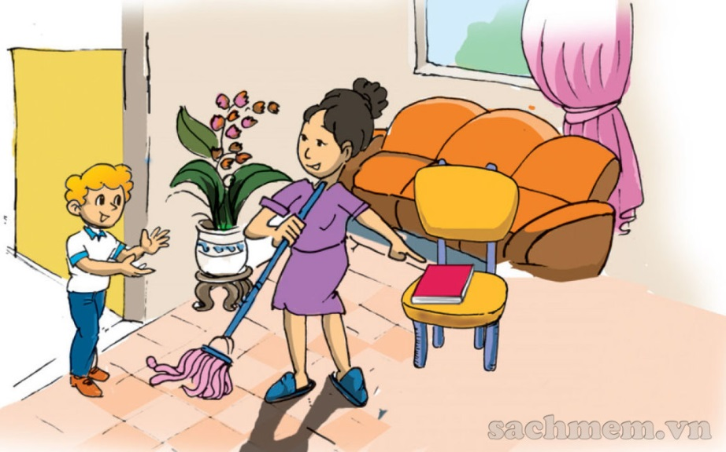
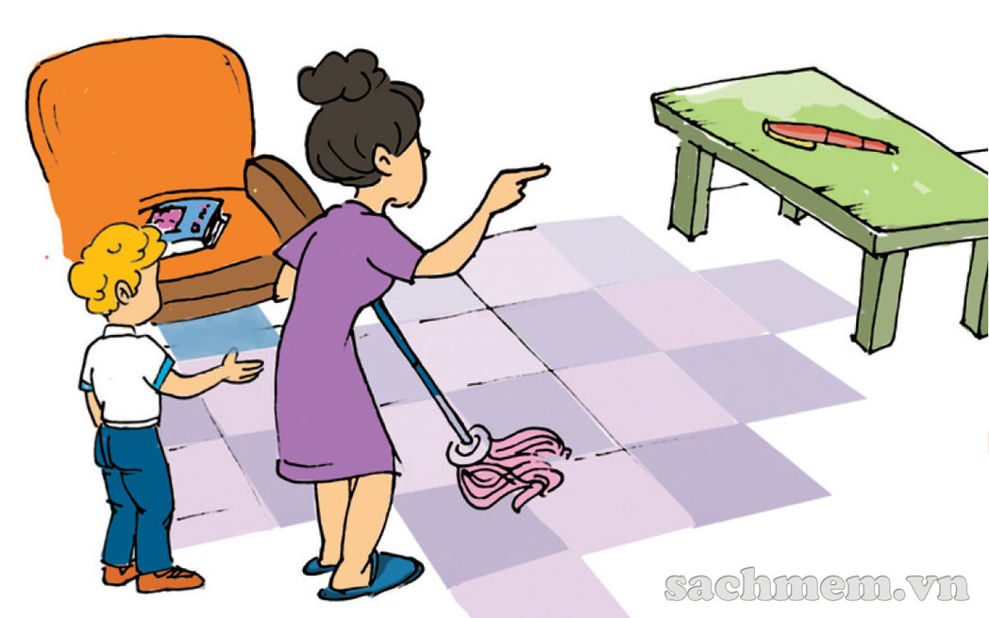
1. Look, listen and repeat.
Where’s my book, mom ?
I can’t see it in my room !
No, it’s not on the chair.
It’s there, on the table.
It’s here, dear.
On the chair!
Is the pen there too, Mum.

Slide 4
Tuesday, April 14th , 2020
Unit 13 : Where’s my book ?
Lesson 1
I. Vocabulary :
poster : tấm áp phích
picture : bức tranh
bed : cái giường
coat : cái áo khoác
ball : quả bóng
chair : cái ghế
here : ở đây
there : ở kia

Slide 5
Where’s my book, Mum ?
It’s here.

Slide 6
II. Sentence pattern:
- Where’s the ……?
( ……… ở đâu ?)
It’s here / there .
Ex 1: - Where’s the poster ?
It’s here.
Ex 1: - Where’s the bed ?
It’s there.

Slide 7
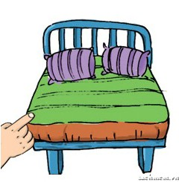
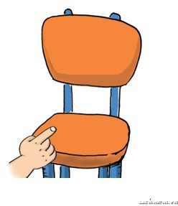
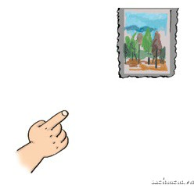
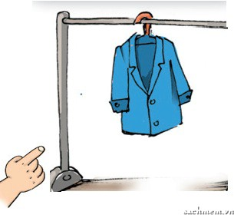
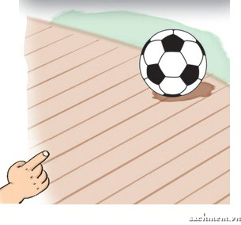
2. Point and say :
- Where’s the……?
It’s……
a. poster
b. bed
c. chair
c. picture
d. coat
d. ball

Slide 8
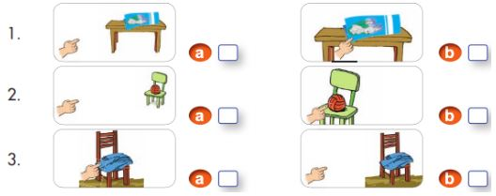
3. Listen and tick :

Slide 9
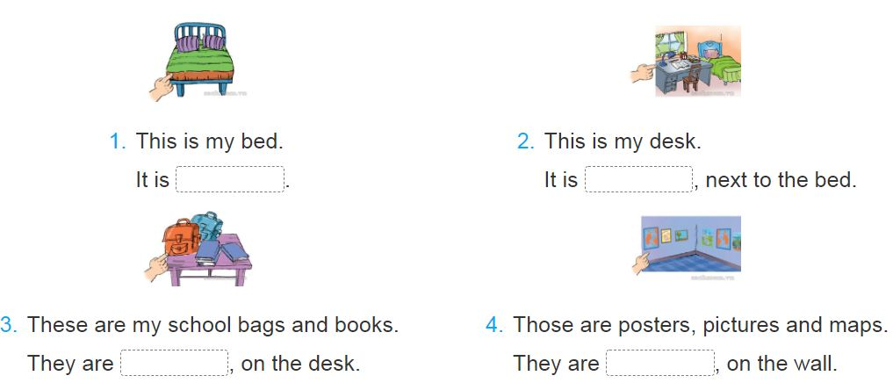
4. Look and write :
here
here
here
there

